Slide 1

11.13.24

Slide 2
Learning Objectives
Reading Files
Variables & Arrays
For Loops
Scripts

Slide 3
Quick Recap of LINUX commands (for ref.)
cd change directory
pwd print working dir.
echo print
mv move
cp copy
ls list contents
mkdir make directory
> write to file
>> append to file
rm remove
touch make file
$ expand variable
# comment

Slide 4
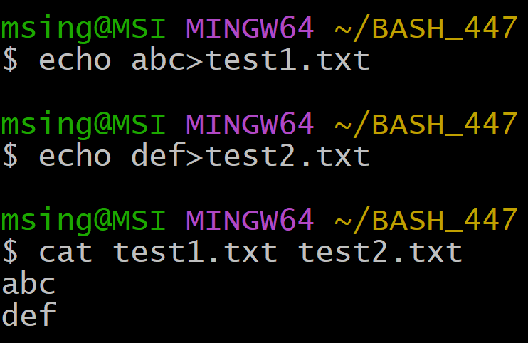
cat
Simplest usage: view file, if multiple passed, display in order passed:

Slide 5
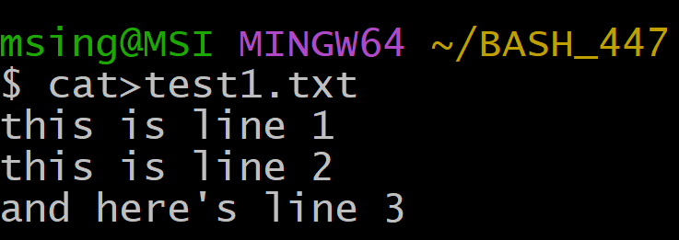
cat
Create and write to a file
cat > filename.txt (or cat>>filename.txt for append onto existing)
Everything you type after will be written to the file until you press ctrl+D
Useful for writing some quick notes while in the terminal

Slide 6
cat
Combining file contents
cat file1.txt file2.txt > newFile.txt
Writes file1.txt, followed by file2.txt to newFile
Same thing for append with >>
cat * displays all files/folders in a directory, hence
cat * > newFile.txt combines all text files (+ folder names) into a single file

Slide 7
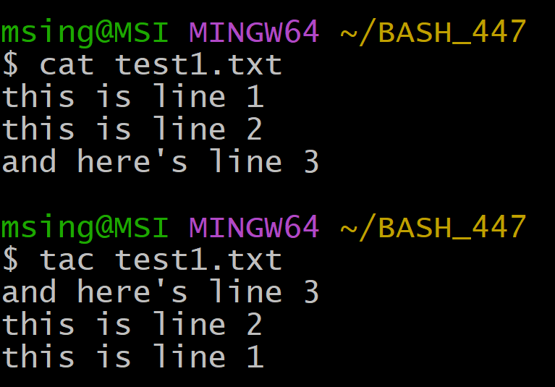

tac
Display in reverse line order (tac=cat backwards):
cat
tac

Slide 8
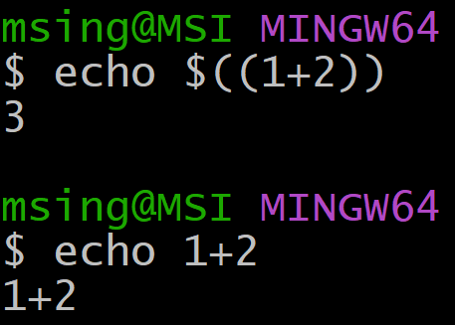
Variables
Variables are declared as usual (a=1, b=abc etc.)
BASH doesn’t have types
Everything is string-like but interpretation depends on context
To evaluate arithmetic expressions:
$((equation))

Slide 9
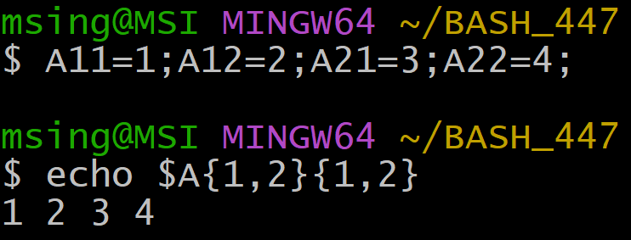
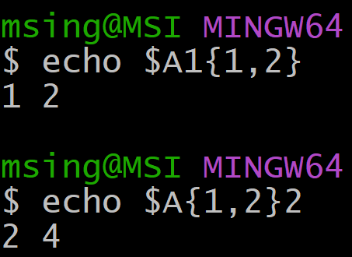
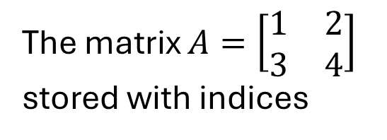
Variables
The plus side is this makes it easy to programmatically name/access variables
The matrix $A=\left[\begin{matrix}1 & 2 \\ 3 & 4\end{matrix}\right]$ stored with indices
A syntax for “slicing” this matrix
(this is just an illustration no one actually does this)

Slide 10
Variables
As seen in previous examples BASH concatenates automatically (no append/+ needed)
To separate variable names use { }
$animals looks for a variable called “animals”
${animal}s gets the variable “animal” and adds an “s” at the end

Slide 11
Arrays in BASH
BASH isn’t object-oriented, so only concrete variables are allowed (no function-objects)
1d arrays store these variables analogous a Python list
stock_names=(“spam” “beet” “kale”)
This creates a standard 1d-style list indexed numerically

Slide 12
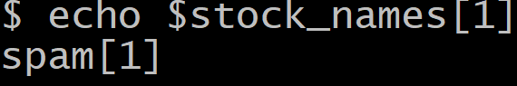
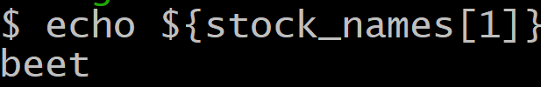
Array Indexing
BASH arrays are 0-indexed and sliced similarly to Python
You can use negative indices. Use @ for “all”
Remember your { } to separate variables from string concatenation!
INCORRECT
CORRECT

Slide 13
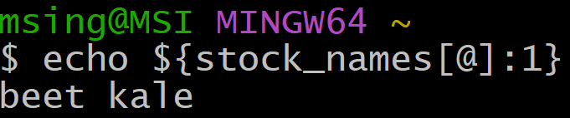
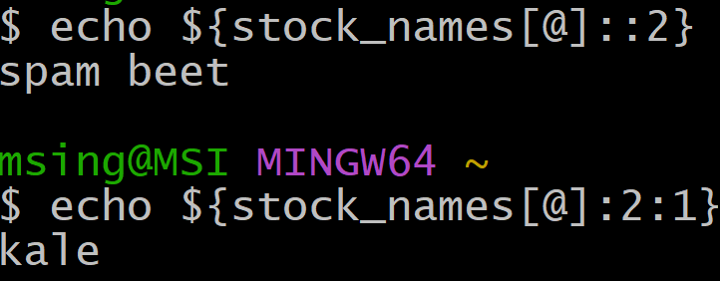
Array Slicing
From index 1 to end
Starting at M ${array[@]:M}
Length K starting at M ${array[@]:K:M}
Length 2 starting at 0
Length 1 starting at 2

Slide 14
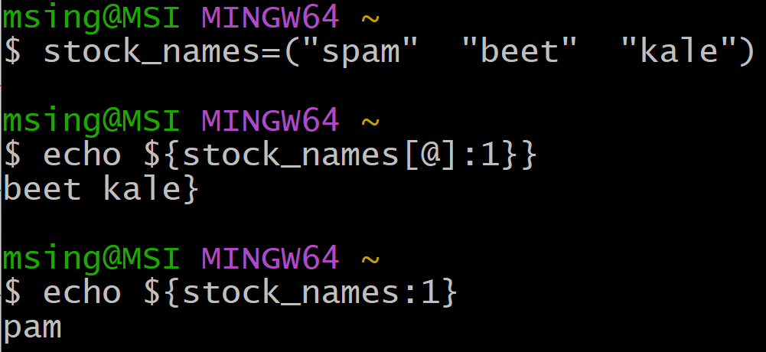

Array Slicing
What happens here? (try it)
Try these and compare the output

Slide 15
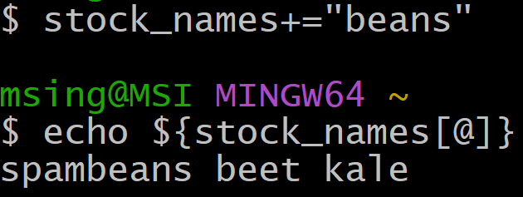
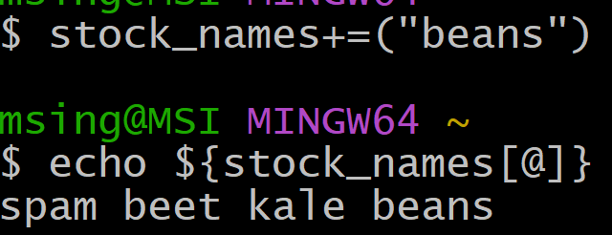
Array Assignment
Like Python, we can append items by direct assignment or +=
Be careful: append with arr += (new_item)
INCORRECT
CORRECT

Slide 16
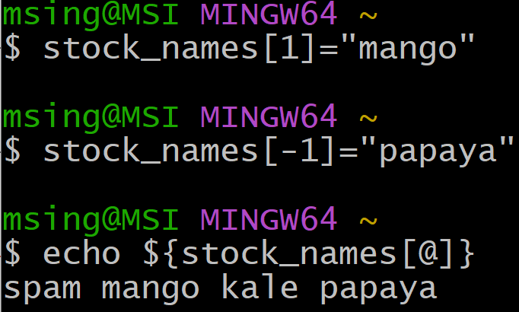
Array Assignment
Direct assignment works similarly to Python, including negative indexing

Slide 17
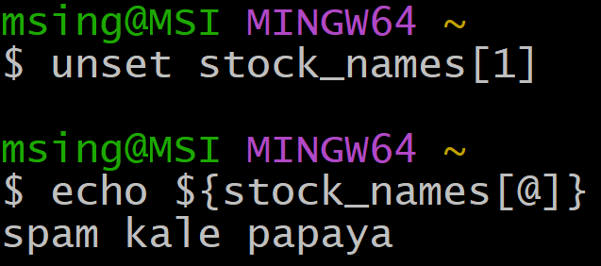
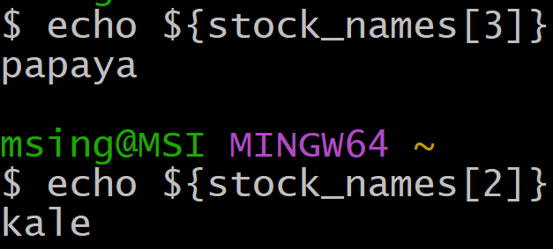
Unassigning Elements with unset
BASH doesn’t automatically “pop” when removing an element
All indices stay the same, that position just becomes “unset”
Here I’ve removed the 2nd element (“mango”)
However, kale and papaya retain their original indices

Slide 18
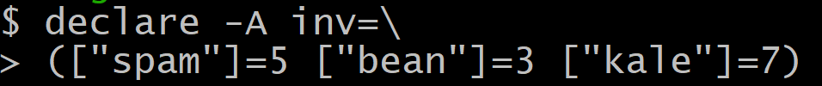

Associative Assignment -A
Associative arrays are key-indexed like Python dictionaries
declare –A specifies that the array is associative
Creating an inventory array
Adding a new key

Slide 19
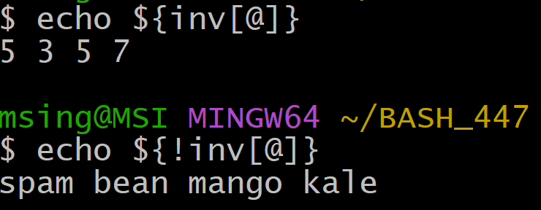
Associative Assignment -A
Items are index in the order they are stored (like Python)
To return keys use ${!array[@]}

Slide 20
For-Loops
val1 val2 val3
for var_name in VALUES
do
done
${val_array[@]}
{1..7}

Slide 21
Example
Let’s write our inventory to a text file
touch inventory.txt
for iFood in "${!inv[@]}"
do
echo "${iFood} : ${inv[$iFood]}">>inventory.txt
done

Slide 22
Practice
Write BASH code that takes the array Z=(“foo” “bar” 3)
and writes each element to a new line of a text file forloop.txt

Slide 23
Scripts
BASH scripts usually start with the “shebang” to make sure the shell is using BASH
#!/bin/bash
Write code to a .sh file
Call with bash scriptname.sh

Slide 24
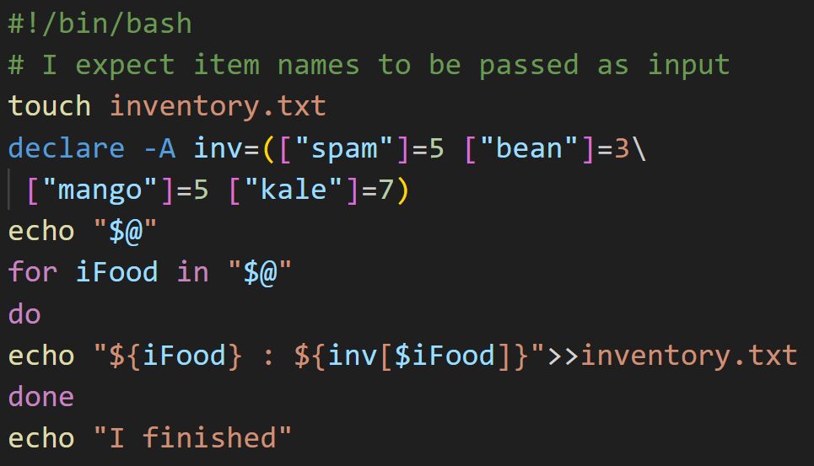
Inventory Script
The best way to send output from a script is using echo

Slide 25
Inventory Script
Inputs to a script can be referenced positionally
bash tmpScript.sh "spam" "bean"
$1
$2
$@ refers to all arguments supplied

Slide 26
Inventory Script
This script takes food names as arguments and prints inventory for that food

Slide 27
Learning Objectives
Reading Files
Variables & Arrays
For Loops
Scripts

Slide 28
Fin

